Slide 1
University of Gujrat Department of Computer Science
Course Code : CS-252
Computer Organization and Assembly Language
Lecture # 3
Data Representation and Conversion
Boolean Operations

Slide 2
Data Representation & Conversion

Slide 3

Data Representation
How do computers represent data?
Most computers are digital
Recognize only two discrete states: on or off
Computers are electronic devices powered by electricity, which has only two states, on or off
on
1 1 1 1 1
off
0 0 0 0 0

Slide 4
Number Systems
Different ways to say how many

Slide 5
Number Systems
Decimal (0-9) Base 10
Binary (0,1) Base 2
Octal (0-7) Base 8
Hexadecimal (0-F) {0-9, A, B, C, D, E, F} Base 16

Slide 6
Decimal Number System
The prefix “deci-” stands for 10
The decimal number system is a Base 10 number system: –
There are 10 symbols that represent quantities:
0, 1, 2, 3, 4, 5, 6, 7, 8, 9
Positional Number system - each digit is associated with the power of 10
For e.g.
3,932 = 3 x 10³ + 9 x 10² + 3 x 10¹ + 2 x 10⁰

Slide 7
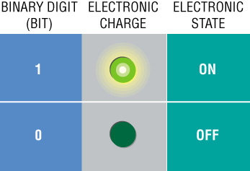
Binary Number System
A number system that has just two unique digits, 0 and 1
A single digit is called a bit (binary digit)
A bit is the smallest unit of data the computer can represent
By itself a bit is not very informative
The two digits represent the two off and on states
Binary Digit (bit)
Electronic Charge
Electronic State

Slide 8
The Octal and Hexadecimal Numbering Systems
Computers use the binary system to represent data. In most cases a number is represented with 16, 32 or more bits, which is difficult to be handled by humans.
To make binary numbers easier to manipulate, we can group the bits of the number in groups of 2, 3 or 4 bits.
If we take a group of 2 bits, then we can have 4 combinations or different digits in each group. Thus the new system is a system with the base of 4.
e.g. (10110100)₂= (10 11 01 00)₂= (2310)₄
(11)₂ = 3
(00)₂ = 0
(10)₂ = 2
(01)₂ = 1

Slide 9
The Octal and Hexadecimal Numbering Systems (Cont.)
If we take a group of 3 bits, then we can have 8 combinations or different digits in each group. Thus the new system is a system with the base of 8 and is called the Octal system.
e.g. (10110100)₂= (10 110 100)₂= (264)₈
If we take a group of 4 bits, then we can have 16 combinations or different digits in each group. Thus the new system is a system with the base of 16 and is called the hexadecimal or hex system. Letters A to F are used to represent digits from 10 to 15.
e.g. (10110100)₂= (1011 0100)₂= (B4)₁₆
(110)₂ = 6
(010)₂ = 2
(100)₂ = 4
(1011)₂ =11=B
(0100)₂ = 4

Slide 10
Decimal, Binary, Octal and Hexadecimal Conversion Table
Decimal Binary Base 4 Octal Hex
0 0000 0 0 0
1 0001 1 1 1
2 0010 2 2 2
3 0011 3 3 3
4 0100 10 4 4
5 0101 11 5 5
6 0110 12 6 6
7 0111 13 7 7
8 1000 20 10 8
9 1001 21 11 9
10 1010 22 12 A
11 1011 23 13 B
12 1100 30 14 C
13 1101 31 15 D
14 1110 32 16 E
15 1111 33 17 F

Slide 11
Conversion from Decimal to a system with base R
A decimal number can be converted into its equivalent in base R using the following procedure:
e.g Decimal Number = 88 R = 2
Step 1: Perform the integer division of the decimal number (88) by R (2) and record the remainder. Replace the decimal number with the result of the division.
Step 2: Repeat step 1, until a zero result is found.
e.g. 2 88
2 44 - 0
2 22 - 0
2 11 - 0
2 5 - 1
2 2 - 1
1 - 0
Step 3: The number is formed by reading the remainders in reversed order.
e.g. (88)₁₀ = (1011000)₂

Slide 12
Binary Arithmetic

Slide 13
Binary Addition
Starting with the LSB, add each pair of digits, include the carry if present.
Addition Rules
0 + 0 = 0
0 + 1 = 1
1 + 0 = 1
1 + 1 = 0
(1 carry to next bit)
Practice: Add 00111101 and 00111100.
13
University of Gujrat

Slide 14
Signed-Magnitude
Used 1st bit of the number as a sign indicator
e.g. +5 → 0101 -5 → 1101 -4 → 1100
Easy to understand but not efficient
Two representations for zero
Complexity of arithmetic and complex hardware (adder, subtractor, comparator) required
ALU performs addition mainly
We would need to redesign the ALU to do arithmetic with signed-magnitude representation
What’s the alternative?

Slide 15
2’s complement
The high-order bit represents the sign but the magnitude is computed differently
Has a single representation for zero
No extra overhead for binary arithmetic
Almost all modern computers use this representation
An n-bit binary number can represent -2^{n-1} – 2^{n-1}-1
(if n=4, -8 – +7 can be represented)

Slide 16
Converting Decimal to 2’s Complement
Get the binary representation for the absolute value of the number
Flip all the bits
Add 1 to the complement
Example
-3
00011 // 5-bit binary for absolute value of -3
11100 // all bits flipped
11101 // 1 added to the complement
Practice: Convert -6 in 2’s complement

Slide 17
Converting 2’s Complement to Decimal
If the high-order bit is 0 then convert the number in the usual way
Else
Subtract 1
Flip all bits
Convert to decimal
Affix a minus sign
Example
11010 // 2’s complement binary
11001 // 1 subtracted
00110 // bits flipped
-6 // affixed the negative sign
.Practice: Convert 11010 to Decimal.

Slide 18
2’s Complement Arithmetic
Binary addition, discard the final carry
Example
Be careful of overflow
For a 5 bit 2’s complement representation
16 is too large!
-17 is too small!
Example:
-3 1101
+ -6 + 1010
---- --------
-9 10111
---- --------

Slide 19
Binary Subtraction
When subtracting A – B, convert B to its two's complement
Add A to (–B)
0 0 0 0 1 1 0 0 0 0 0 0 1 1 0 0
– 0 0 0 0 0 0 1 1 1 1 1 1 1 1 0 1
0 0 0 0 1 0 0 1
Practice: 7+ (-4).

Slide 20
Hexadecimal Arithmetic

Slide 21
Hexadecimal Addition
Divide the sum of two digits by the number base (16). The quotient becomes the carry value, and the remainder is the sum digit.
1
1
36 28 28 6A
42 45 58 4B
78 6D 80 B5
21 / 16 = 1, rem 5
Practice: Add 34F4 and 2A12.

Slide 22
Hexadecimal Subtraction
When a borrow is required from the digit to the left, add 16 (decimal) to the current digit's value:
16 + 5 = 21
−1
C6 75
A2 47
24 2E
Practice: Subtract 2A12 from 34F4.

Slide 23
Character Storage
Character Set
Standard ASCII (0 – 127)
Extended ASCII (0 – 255)
Unicode (0 – 65,535)

Slide 24
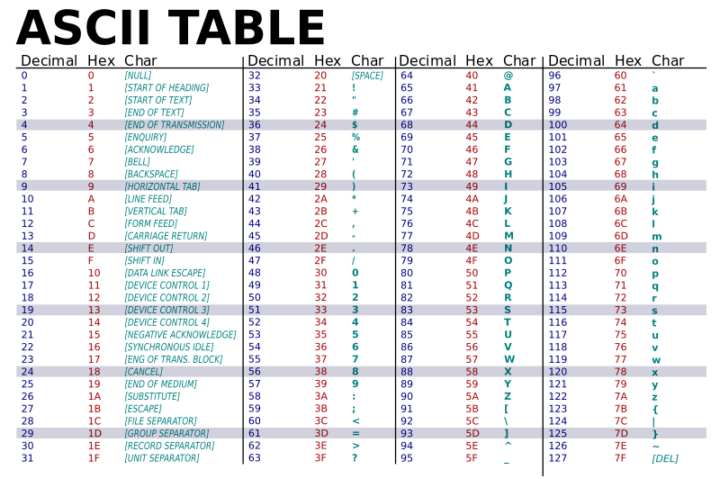

Slide 25
Boolean Operations

Slide 26
Boolean Operations
NOT
AND
OR
Operator Precedence
Truth Tables

Slide 27
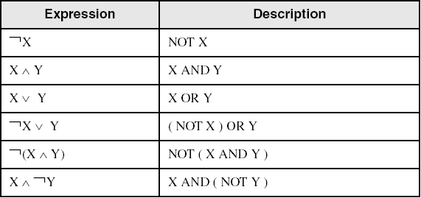
Boolean Algebra
Based on symbolic logic, designed by George Boole
Boolean expressions created from:
NOT, AND, OR

Slide 28
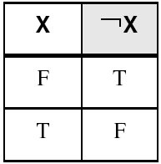
NOT
Inverts (reverses) a boolean value
Truth table for Boolean NOT operator:
Digital gate diagram for NOT:

Slide 29
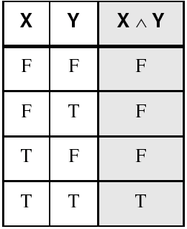
AND
Truth table for Boolean AND operator:
Digital gate diagram for AND:

Slide 30
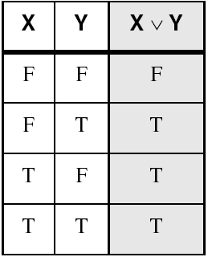
OR
Truth table for Boolean OR operator:
Digital gate diagram for OR:
University of Gujrat

Slide 31
NAND &&& NOr
NANd is reverse of AND
NOR is reverse of OR

Slide 32
XOR
IF both inputs are false or both inputs are ture false output is returned by XOR.

Slide 33
XOR
A | B | A XOR B
F | F | F
T | F | T
F | T | T
T | T | F

Slide 34
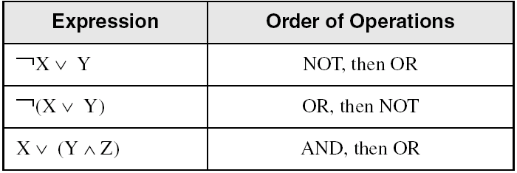
Operator Precedence
Examples showing the order of operations:
University of Gujrat

Slide 35
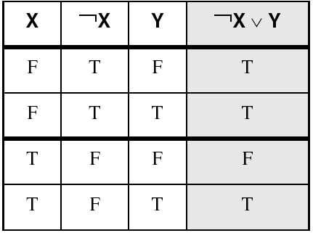
Truth Tables (1 of 3)
A Boolean function has one or more Boolean inputs, and returns a single Boolean output.
A truth table shows all the inputs and outputs of a Boolean function
Example: ¬X ∨ Y
University of Gujrat

Slide 36
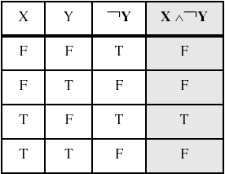
Truth Tables (2 of 3)
Example: X ∧ ¬Y
University of Gujrat

Slide 37
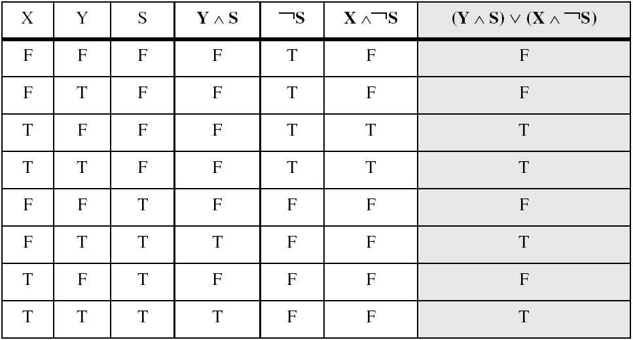
Truth Tables (3 of 3)
Example: (Y ∧ S) ∨ (X ∧ ¬S)
Practice: (¬Y v S ) ∧ (X v S).

Slide 38
THE END

